Slide 1
Lecture 12 Graphs
Department of Computer Science
Hofstra University
Acknowledgement: Lecture slides based on UofW Course on Data Structures

Slide 2
Inter-data Relationships
Arrays
Trees
Graphs
Elements only store pure data, no connection info
Only relationship between data is order
Elements store data and connection info
Directional relationships between nodes; limited connections
Elements AND connections can store data
Relationships dictate structure; huge freedom with connections
C
B
0 | 1 | 2
A | B | C
B
A
C
A

Slide 3
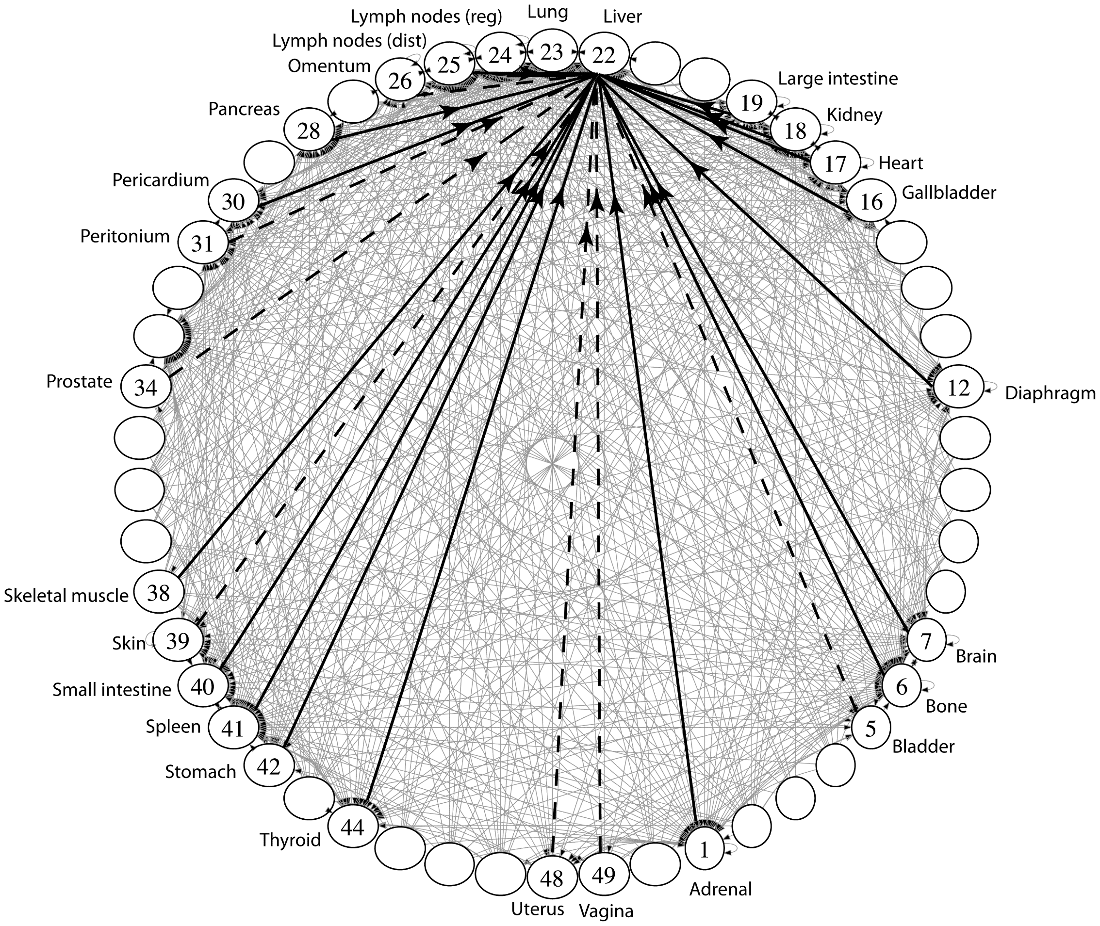
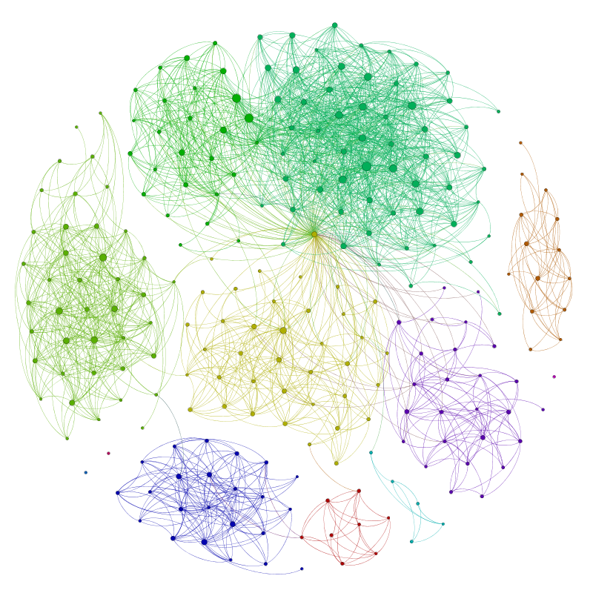
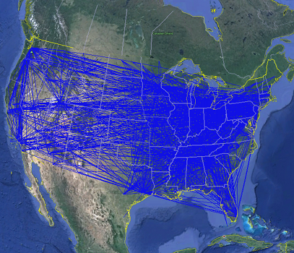
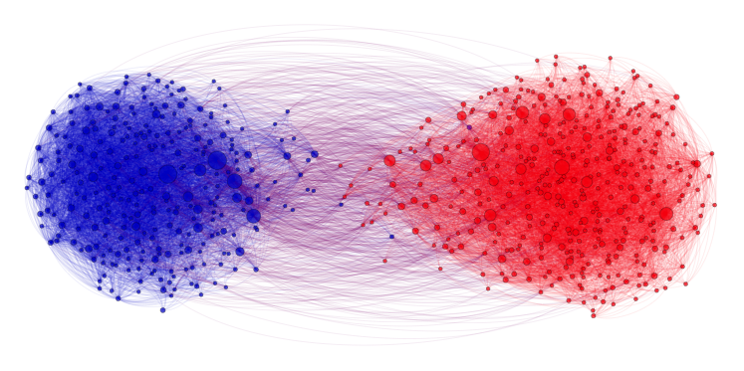
Applications
Physical Maps
Airline maps
nodes are airports, edges are flight paths
Traffic
nodes are addresses, edges are streets
Relationships
Social media graphs
nodes are accounts, edges are follower relationships
Traffic
nodes are classes, edges are usage
Influence
Biology
nodes are cancer cell desinations, edges are migration paths
Related topics
Web Page Ranking
nodes are web pages, edges are hyperlinks
Wikipedia
nodes are articles, edges are links
And so many more!!
www.allthingsgraphed.com

Slide 4
Graph: Formal Definition
G
A graph is defined by a pair of sets G = (V, E) where…
V is a set of nodes
A node or “node” is a data entity
V = { A, B, C, D, E, F, G, H }
E is a set of edges
An edge is a connection between two nodes
E = { (A, B), (A, C), (A, D), (A, H),
(C, B), (B, D), (D, E), (D, F),
(F, G), (G, H)}
H
F
A
D
C
B
E

Slide 5
Graph Terminology
Undirected Graph:
Graph Direction
Undirected graph – edges have no direction and are two-way
V = { Karen, Jim, Pam }
E = { (Jim, Pam), (Jim, Karen) } inferred (Karen, Jim) and (Pam, Jim)
Directed graphs – edges have direction and are thus one-way
V = { Gunther, Rachel, Ross }
E = { (Gunther, Rachel), (Rachel, Ross), (Ross, Rachel) }
Degree of a Node
Degree – the number of edges connected to that node
Karen : 1, Jim : 1, Pam : 1
In-degree – the number of directed edges that point to a node
Gunther : 0, Rachel : 2, Ross : 1
Out-degree – the number of directed edges that start at a node
Gunther : 1, Rachel : 1, Ross : 1
Karen
Jim
Directed Graph:
Pam
Rachel
Gunther
Ross

Slide 6
More Graph Terminology
j
f
g
Two nodes are connected if there is a path between them
If all the nodes are connected, we say the graph is connected
A directed graph is weakly connected if replacing every directed edge with an undirected edge results in a connected graph
A directed graph is strongly connected if a directed path exists between every pair of nodes
The number of edges leaving a node is its degree
A path is a sequence of nodes connected by edges
A simple path is a path without repeated nodes
A cycle is a path whose first and last nodes are the same
A graph with a cycle is cyclic
e
not connected
d
b
c
a
i
p
n
connected
o
m
i
p
n
o
m

Slide 7
Directed vs Undirected; Acyclic vs Cyclic
Directed:
Undirected:
b
b
e
Acyclic:
a
d
a
d
c
c
b
b
Cyclic:
a
d
a
d
c
c

Slide 8
Labeled and Weighted Graphs
Node Labels
Node & Edge Labels
Edge Labels
b
e
c
2
c
5
a
d
a
d
a
d
1
3
b
b
c
4
Numeric Edge Labels (Edge Weights)
3
1
1
2

Slide 9
Multi-Variable Analysis
So far, we thought of everything as being in terms of some single argument “n”
With graphs, we need to consider:
n (or |V|): total number of nodes (sometimes written as V)
m (or |E|): total number of edges (sometimes written as E)
deg(u): degree of node u (how many outgoing edges it has)

Slide 10
Adjacency Matrix
4
0
1
5
6
In an adjacency matrix a[u][v] is 1 if there is an edge (u,v), and 0 otherwise.
Worst-case Time Complexity (|V| = n, |E| = m):
Add Edge:
Remove Edge:
Check edge exists from (u,v):
Get out-neighbors of u:
Get in-neighbors of u:
Space Complexity:
More suitable for dense graphs
2
3
 | 0 | 1 | 2 | 3 | 4 | 5 | 6
0 | 0 | 1 | 1 | 0 | 0 | 0 | 0
1 | 1 | 0 | 0 | 1 | 0 | 0 | 0
2 | 1 | 0 | 0 | 1 | 0 | 0 | 0
3 | 0 | 1 | 1 | 0 | 0 | 1 | 0
4 | 0 | 0 | 0 | 0 | 0 | 1 | 0
5 | 0 | 0 | 0 | 1 | 1 | 0 | 0
6 | 0 | 0 | 0 | 0 | 0 | 0 | 0
O(1)
O(1)
O(1)
O(n)
O(n)
O(n²)
For an undirected graph, adjacency matrix is symmetric w.r.t diagonal line. A node u’s out-neighbors are the same as its in-neighbors
Notes:
It is usual to write |V| = n and |E| = m, though sometimes we’ll abuse notation and just use V and E.
Adjacency Matrices take more space, why would you use them?
For dense graphs (where m is close to n²), the running times will be close
And the constant factors can be much better for matrices than for lists

Slide 11
Adjacency List
B
A
In an adjacency matrix a[u][v] is 1 if there is an edge (u,v), and 0 otherwise.
Worst-case Time Complexity (|V| = n, |E| = m):
Add Edge:
Remove Edge:
Check edge exists from (u,v):
Get outneighbors of u:
Get inneighbors of u:
Space Complexity:
More suitable for sparse graphs
C
D
Linked Lists
0
1
2
3
O(1)
A
B
C
O(deg(u))
B
O(deg (u))
O(deg(u))
C
B
D
O(n + m)
O(n + m)
D
A

Slide 12
Adjacency List
B
In an adjacency matrix a[u][v] is 1 if there is an edge (u,v), and 0 otherwise.
Worst-case Time Complexity (assuming a good hash function so all hash table operations are O(1)) (|V| = n, |E| = m):
Add Edge:
Remove Edge:
Check edge exists from (u,v):
Get outneighbors of u:
Get inneighbors of u:
Space Complexity:
A
C
D
Hash Tables
0 | 1 | 2 | 3 | 4
0
1
2
3
O(1)
A
B
C
O(1)
B
O(1)
0 | 1 | 2 | 3 | 4
O(deg(u) )
C
B
D
O(n)
0 | 1 | 2 | 3 | 4
D
A
O(n + m)
Notes:
For this class, unless we say otherwise, we’ll assume the hash tables operations on graphs are all O(1)
Because you can probably control the keys
Unless we say otherwise, assume we’re using the hash table approach

Slide 13
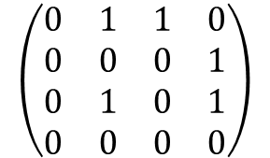
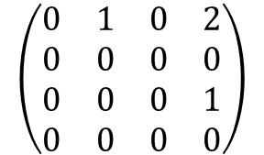
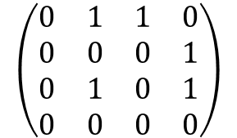
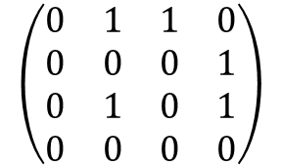
2-Hop Neighbors (through Matrix Multiplication)
Matrix multiplication for finding two-hop neighbors
Node 3 is a two-hop neighbor of node 0 along two different paths
 | 0 | 1 | 2 | 3
0 | 0 | 1 | 1 | 0
1 | 0 | 0 | 0 | 1
2 | 0 | 1 | 0 | 1
3 | 0 | 0 | 0 | 0
 | 0 | 1 | 2 | 3
0 | 0 | 1 | 0 | 2
1 | 0 | 0 | 0 | 0
2 | 0 | 0 | 0 | 1
3 | 0 | 0 | 0 | 0
0
1
Node 3 is a two-hop neighbor of node 2 along 1 path
2
3
A graph and its adjacency matrix representation
The adjacency matrix representation
The adjacency matrix representation for two-hop neighbors, obtained by matrix-matrix product of the adjacency matrix
2
$$\left(\begin{matrix}0 & 1 & 1 & 0 \\ 0 & 0 & 0 & 1 \\ 0 & 1 & 0 & 1 \\ 0 & 0 & 0 & 0\end{matrix}\right)$$
$$\left(\begin{matrix}0 & 1 & 1 & 0 \\ 0 & 0 & 0 & 1 \\ 0 & 1 & 0 & 1 \\ 0 & 0 & 0 & 0\end{matrix}\right)$$
$$\left(\begin{matrix}0 & 1 & 1 & 0 \\ 0 & 0 & 0 & 1 \\ 0 & 1 & 0 & 1 \\ 0 & 0 & 0 & 0\end{matrix}\right)$$
$$\left(\begin{matrix}0 & 1 & 0 & 2 \\ 0 & 0 & 0 & 0 \\ 0 & 0 & 0 & 1 \\ 0 & 0 & 0 & 0\end{matrix}\right)$$
=
=
Notes:
Matrix multiplication is well studied and optimized in software and hardware, and can be done very fast
For all the nodes in the graph
Consider the multiplication of the first row of the left matrix wit the last column of the right matrix:
0*0 + 1*1 + 1*1 + 0*0 = 2.
This means that there are two 2-hop paths from 1 to 3:
Path 0→1→ 3 consisting of two edges 0→1 & 1→ 3, corresponding to the first term of 1*1
Path 0→2→ 3 consisting of two edges 0→2 &2→ 3, corresponding to the second term of 1*1

Slide 14
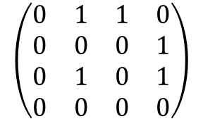
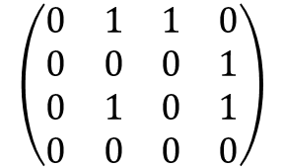
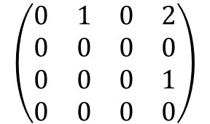
2-Hop Neighbors (through Matrix Multiplication)
Consider the multiplication of the first row of the left matrix wit the last column of the right matrix:
0*0 + 1*1 + 1*1 + 0*0 = 2.
This means that there are two 2-hop paths from 1 to 3:
Path 0→1→ 3 consisting of two edges 0→1 & 1→ 3, corresponding to the first term of 1*1
Path 0→2→ 3 consisting of two edges 0→2 &2→ 3, corresponding to the second term of 1*1
Path 0→1→ 3
$$\left(\begin{matrix}0 & 1 & 1 & 0 \\ 0 & 0 & 0 & 1 \\ 0 & 1 & 0 & 1 \\ 0 & 0 & 0 & 0\end{matrix}\right)$$
$$\left(\begin{matrix}0 & 1 & 1 & 0 \\ 0 & 0 & 0 & 1 \\ 0 & 1 & 0 & 1 \\ 0 & 0 & 0 & 0\end{matrix}\right)$$
$$\left(\begin{matrix}0 & 1 & 0 & 2 \\ 0 & 0 & 0 & 0 \\ 0 & 0 & 0 & 1 \\ 0 & 0 & 0 & 0\end{matrix}\right)$$
0
1
=
2
3
Path 0→2→ 3

Slide 15
Graph Traversals
Topological Sort
Shortest Path

Slide 16
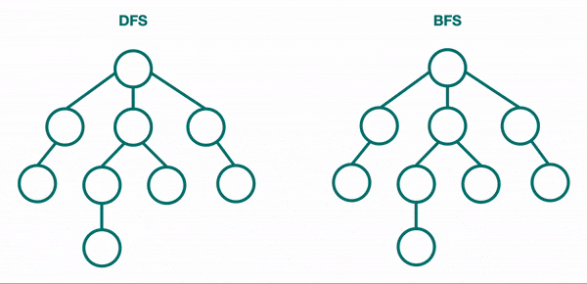
BFS & DFS for Trees

Slide 17
Breadth-First Search (BFS)
BFS: Explore nodes “layer by layer”; like level-order traversal of a tree, now generalized to any graph; visit 1-hop neighbors, then 2-hop neighbors, …, until all nodes have been visited
2
3
VISITED
4
This is our goal, but how do we translate into code?
Use a data structure to ”queue up” children…
s
1
9
7
0
2
4
1
5
for (Node n : s.neighbors) {
6
3
8
Notes:
Key observation: recursive calls interrupted s.neighbors loop to immediately process children
For BFS, instead we want to complete that loop before processing children
closer nodes first, instead of following one choice all the way to the end

Slide 18
BFS Implementation
A queue keeps track of “outer edge” of nodes still to explore
bfs(Graph graph, Node start) {
Queue<Node> perimeter = new Queue<>();
Set<Node> visited = new Set<>();
perimeter.add(start);
visited.add(start);
Kick off the algorithm by adding start to perimeter
while (!perimeter.isEmpty()) {
Node from = perimeter.remove();
3
Grab one element at a time from the perimeter
for (Edge edge : graph.edgesFrom(from)) {
Node to = edge.to();
4
Look at all that element’s children
if (!visited.contains(to)) {
perimeter.add(to);
visited.add(to);
}
}
}
}
start
1
9
7
Add new ones to perimeter!
2
5
6
8

Slide 19
BFS Implementation: In Action
PERIMETER
bfs(Graph graph, Node start) {
Queue<Node> perimeter = new Queue<>();
Set<Node> visited = new Set<>();
perimeter.add(start);
visited.add(start);
while (!perimeter.isEmpty()) {
Node from = perimeter.remove();
for (Edge edge : graph.edgesFrom(from)) {
Node to = edge.to();
if (!visited.contains(to)) {
perimeter.add(to);
visited.add(to);
}
}
}
}
1
2
4
5
3
6
8
9
7
3
VISITED
start
4
1
9
7
2
5
6
8

Slide 20
BFS Intuition: Why Does it Work?
Using FIFO queue means we explore an entire layer before moving on to the next layer
Keep going until perimeter is empty
PERIMETER
bfs(Graph graph, Node start) {
Queue<Node> perimeter = new Queue<>();
Set<Node> visited = new Set<>();
perimeter.add(start);
visited.add(start);
while (!perimeter.isEmpty()) {
Node from = perimeter.remove();
for (Edge edge : graph.edgesFrom(from)) {
Node to = edge.to();
if (!visited.contains(to)) {
perimeter.add(to);
visited.add(to);
}
}
}
}
1
2
4
5
3
6
8
9
7
2
3
VISITED
start
4
1
9
0
7
2
4
1
5
6
3
8

Slide 21
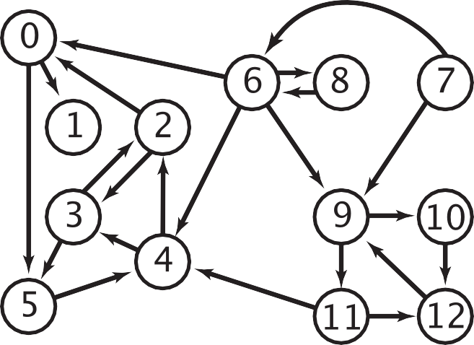



BFS Application: Multiple-Source Shortest Paths Problem
Given a digraph and a set of source nodes, find shortest path from any node in the set to every other node, assuming all edges have weight 1.
e.g., S = { 1, 7, 10 }.
Shortest path to 4 is 7 → 6 → 4.
Shortest path to 5 is 7 → 6 → 0 → 5.
Shortest path to 12 is 10 → 12.
Can be done with BFS, and initialize by enqueuing all source nodes
0
1
6
5
8
7
9
2
4
10
12
3
11
dist = 0
dist = 1
dist = 2
dist = 3

Slide 22
Depth-First Search (DFS) (Recursive Algorithm)
DFS explores one branch “all the way down” before coming back to try branches
Depending on the order of visiting branches, many possible orderings: e.g., {1, 2, 5, 6, 9, 7, 8, 4, 3}, {1, 4, 3, 2, 5, 8, 6, 7, 9}, etc.
Set<Node> visited; // assume global
connected(Node s, Node t) {
if (s == t) {
return true;
} else {
visited.add(s);
for (Node n : s.neighbors) {
if (!visited.contains(n)) {
if (connected(n, t)) {
return true;
}
}
}
return false;
}
}
VISITED
3
s
1
4
7
9
2
5
6
8
Notes:
What order does this algorithm use to visit nodes?
Assume order of s.neighbors is arbitrary!

Slide 23
DFS w/ Stack vs. BFS w/ Queue
dfs(Graph graph, Node start) {
Stack<Node> perimeter = new Stack<>();
Set<Node> visited = new Set<>();
perimeter.add(start);
while (!perimeter.isEmpty()) {
Node from = perimeter.remove();
if (!visted.contains(from)) {
for (Edge edge:graph.edgesFrom(from)) {
Node to = edge.to();
perimeter.add(to)
}
visited.add(from);
}
}
}
bfs(Graph graph, Node start) {
Queue<Node> perimeter = new Queue<>();
Set<Node> visited = new Set<>();
perimeter.add(start);
visited.add(start);
while (!perimeter.isEmpty()) {
Node from = perimeter.remove();
for (Edge edge : graph.edgesFrom(from)) {
Node to = edge.to();
if (!visited.contains(to)) {
perimeter.add(to);
visited.add(to);
}
}
}
}
Notes:
In DFS we can’t immediately add a node as “visited”. We need to make sure we are only marking the node when it is popped.

Slide 24
Recap: Graph Traversals
DFS
(Iterative)
Follow a “choice” all the way to the end, then come back to revisit other choices
Uses a stack!
BFS
(Iterative)
Explore layer-by-layer: examine every node at a certain distance from start, then examine nodes that are one level farther
Uses a queue!
DFS
(Recursive)
On huge graphs, might overflow the call stack

Slide 25
Topological Sort
Given a DAG
A Directed Acyclic Graph (DAG) : A directed graph (digraph) without any cycles
A DAG encodes a “dependency graph”
An edge (u, v) means u must precede v
A topological sort or topological ordering of a DAG gives a total node ordering that respects dependencies
Applications:
Compiling multiple Java files
Multi-job Workflows
A before C
A
A before B
C
B
B before C
Topological Sort:
A
B
C
C before A
A
With original edges for reference:
A before B
C
B
A
B
C
B before C
Not a DAG. No possible topological sort
Notes:
A directed graph without any cycles
Edges may or may not be weighted
Given: a DAG, find: a total ordering of the nodes so all edges go from left to right (all the dependency arrows are satisfied and the nodes can be processed left to right with no problems) .
A topological sort of a directed acyclic graph (DAG) G is an ordering of the nodes, where for every edge in the graph, the origin appears before the destination in the ordering
If a node doesn’t have any edges going into it, we can add it to the ordering.
In general, topological sorts are not unique

Slide 26
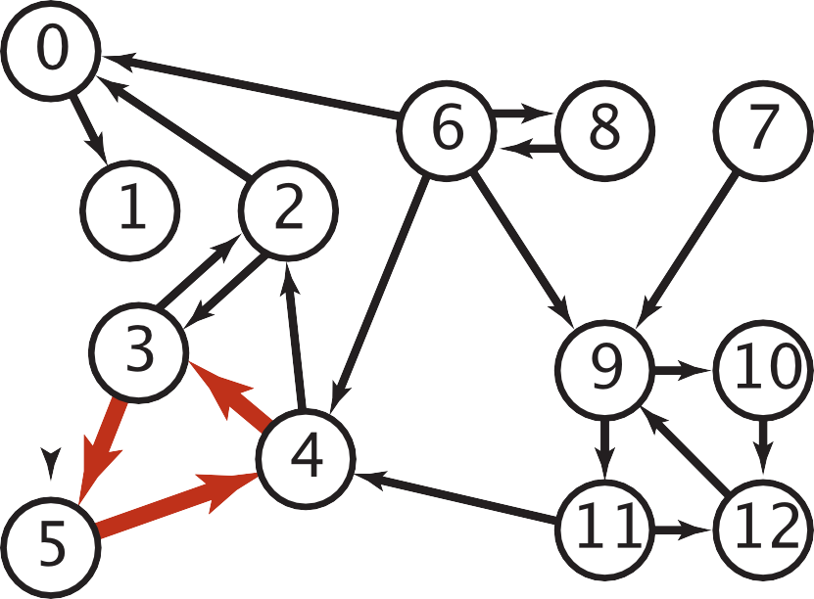

Cycles and Undirected Edges
Why is topological sort not possible for digraphs containing cycles?
Imagine a graph with 3 nodes and edges = {1 to 2 , 2 to 3, 3 to 1} forming a cycle. Now if we try to topologically sort this graph starting from any node, it will always create a contradiction to our definition. All the nodes in a cycle are indirectly dependent on each other hence topological sortfails
Why is topological sort not possible for graphs with undirected edges?
Special case of a cycle. Undirected edge between two nodes u and v means, there is an edge from u to v as well as from v to u. Because of this both the nodes u and v depend upon each other and none of them can appear before the other in the topological sortwithout creating a contradiction
a digraph with a directed cycle

Slide 27
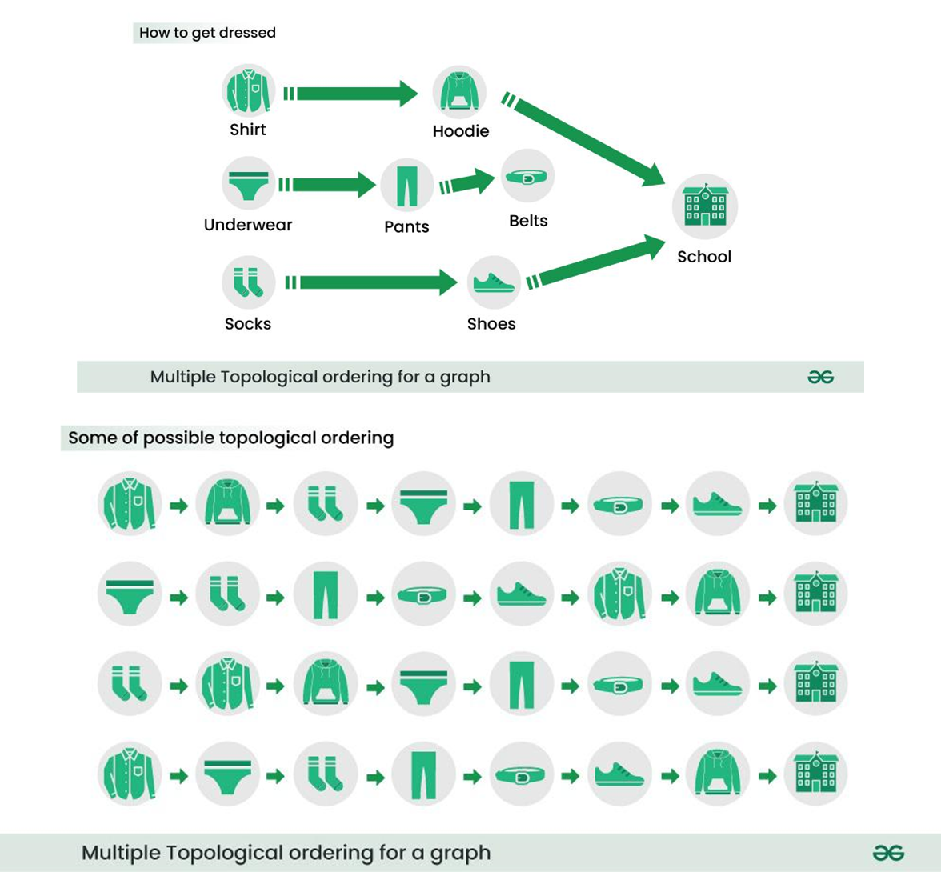
Topological Sort Example I

Slide 28
Topological Sort Example II
Give all possible topological orderings of this DAG
A
C
D
B
E
By observation, we can get (A, C, B, D, E), (A, C, B, E, D)
Notes:
More generally, if the only incoming edges are from nodes already in the ordering, it’s safe to add.

Slide 29
Topological Sort Example III
Give all possible topological orderings of this DAG
A
C
D
B
E
E
By observation, we can get: all possible interleavings with (AB) or (BA) before C, (DEF) or (DFE) or (EFD) after C. e.g., ABCDEF, BACEDF, etc.

Slide 30
Topological Sort by DFS Post-Order Traversal
Perform DFS Post-Order Traversal starting from any node (often, but not necessarily, a node with no incoming edges (no predecessors)) to get an ordered list of nodes, then reverse the node order to get a Topological Sort
Upon finishing traversal starting from one node, restart from another unvisited node with no incoming edges
This results in one of multiple possible Topological Sorts
Intuition: DFS Post-Order Traversal outputs nodes from the deepest (furthest away from the starting node) to the starting mode, hence the reverse order is a Topological Sort from the starting node

Slide 31
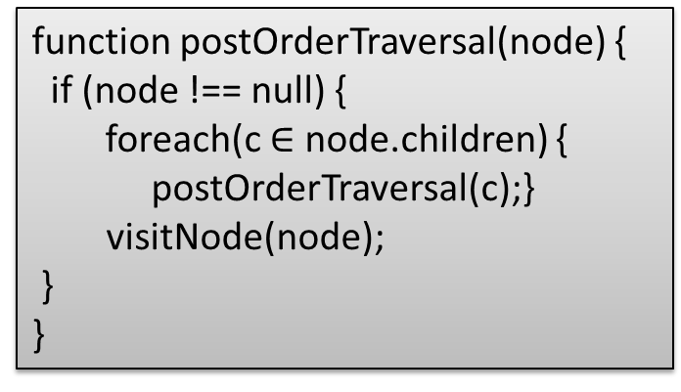
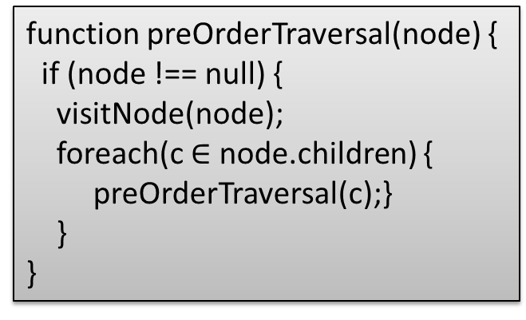
DFS Traversal: Pre-order, Post-order
function preOrderTraversal(node) {
if (node !== null) {
visitNode(node);
preOrderTraversal(node.left);
preOrderTraversal(node.right);
}
}
function postOrderTraversal(node) {
if (node !== null) {
postOrderTraversal(node.left);
postOrderTraversal(node.right);
visitNode(node);
}
}
Recall: Binary Tree traversal with DFS: pre-order, post-order
function preOrderTraversal(node) {
if (node !== null) {
visitNode(node);
foreach(c $∈$ node.children) {
preOrderTraversal(c);}
}
}
function postOrderTraversal(node) {
if (node !== null) {
foreach(c $∈$ node.children) {
postOrderTraversal(c);}
visitNode(node);
}
}
Graph traversal with DFS: pre-order, post-order (for post-order, visit a node during backtrack when all its children have been visited)

Slide 32
DFS Traversal Example I
Start from node 0
Visit nodes 0->1->4. Since 4 has no successors, backtrack to 0.
Pre-order: (0, 1, 4); post-order: (4, 1)
Visit node 2. Since 2 has no successors, backtrack to 0
Pre-order: (0, 1, 4, 2); post-order: (4, 1, 2)
Visit node 5. Since 5’s successor 2 has been visited, backtrack to 0. Since all of node 0’s successors have been visited, we visit it in post-order
Pre-order: (0, 1, 4, 2, 5); post-order: (4, 1, 2, 5, 0)
Restart from node 3, visit its successor 6, then backtrack. Since all of node 3’s successors have been visited, we visit it in post-order
Pre-order: (0, 1, 4, 2, 5, 3, 6); post-order: (4, 1, 2, 5, 0, 6, 3)
All nodes and their successors have been visited, so the algorithm terminates. A topological sort corresponding to this post-order is (3, 6, 0, 5, 2, 1, 4)
This is one of many possible traversals, e.g., if we start from another node 3 with no predecessors, then we have the traversals: pre-order: (3, 5, 2, 4, 6, 0, 1); post-order: (2, 5, 4, 3, 1, 0, 6); Topological sort: (6, 0, 1, 3, 4, 5, 2); BFS traversal: (3, 2, 5, 4, 6, 0, 1)
A BFS traversal: (0, 2, 5, 1, 4, 3, 6)
0
0
2
5
1
3
4
6

Slide 33
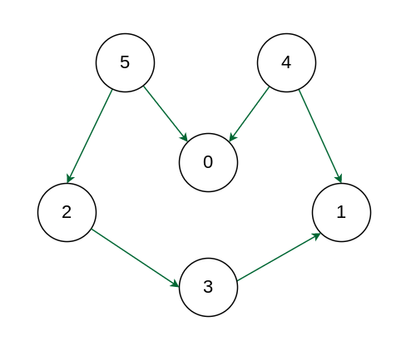
DFS Traversal Example II
Starting from node 5:
Pre-order traversal: (5, 2, 3, 1, 0, 4)
Post-order traversal: (1, 3, 2, 0, 5, 4)
Topological sort: (4, 5, 0, 2, 3, 1)
BFS traversal: (5, 0, 2, 3, 1, 4)
Starting from node 4:
Pre-order traversal: (4, 0, 1, 5, 2, 3)
Post-order traversal: (0, 1, 4, 3, 2, 5)
Topological sort: (5, 2, 3, 4, 1, 0)
BFS traversal: (4, 0, 1, 5, 2, 3)
Starting from node 0:
Pre-order traversal: (0, 5, 2, 3, 1, 4)
Post-order traversal: (0, 1, 3, 2, 5, 4)
Topological sort: (4, 5, 2, 3, 1, 0)
BFS traversal: (0, 5, 2, 3, 1, 4)
You may try starting any other node.

Slide 34
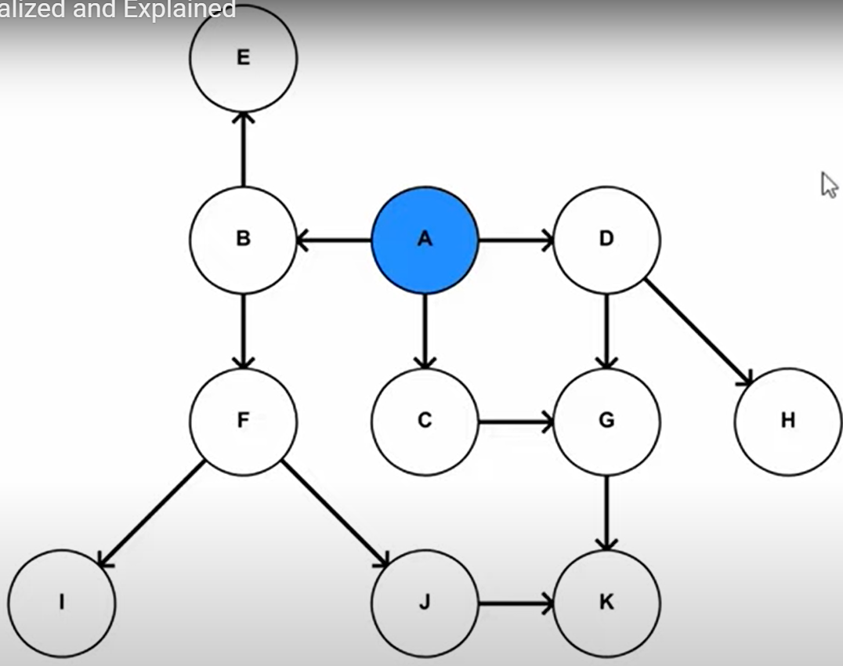
DFS Traversal Example III
Starting from node A:
Pre-order traversal: (A, B, F, I, J, K, E, C, G, D, H)
Post-order traversal: (I, K, J, F, E, B, G, C, H, D, A)
Topological sort: (A, D, H, C, G, B, E, F, J, K, I)
BFS traversal: (A, B, C, D, E, F, G, H, I, J, K)
Starting from a different node will give a different topological sort, but all of them must start with A, since it is the only node without any predecessors (i.e., it must precede all the other nodes based on the DAG)
Any post-order traversal must visit A last, since all of A’s sucessors must be visited before visiting A
Topological Sort Visualized and Explained
https://www.youtube.com/watch?v=7J3GadLzydI
Notes:
A topological sort is reverse order of Post-order traversal: “A D H C G B E F J K I”.

Slide 35
Kahn’s algorithm for Topological Sort
The algorithm works by repeatedly finding nodes with no incoming edges, removing them from the graph, and updating the incoming edges of the remaining nodes. This process continues until all nodes have been ordered.
Add all nodes with in-degree 0 to a queue.
While the queue is not empty:
Remove a node from the queue.
For each outgoing edge from the removed node, decrement the in-degree of the destination node by 1.
If the in-degree of a destination node becomes 0, add it to the queue.
If the queue is empty and there are still nodes in the graph, the graph contains a cycle and cannot be topologically sorted.
The nodes in the queue represent the topological sort of the graph.
Time Complexity: O(V+E).
The outer for loop will be executed V number of times and the inner for loop will be executed E number of times.
https://www.geeksforgeeks.org/topological-sorting-indegree-based-solution/

Slide 36
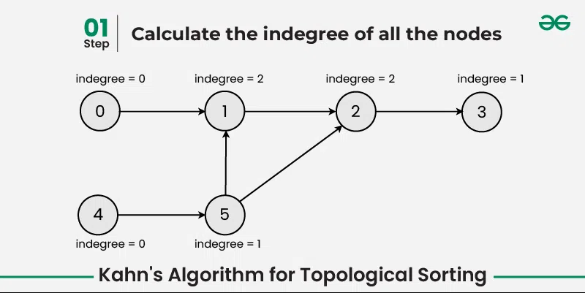
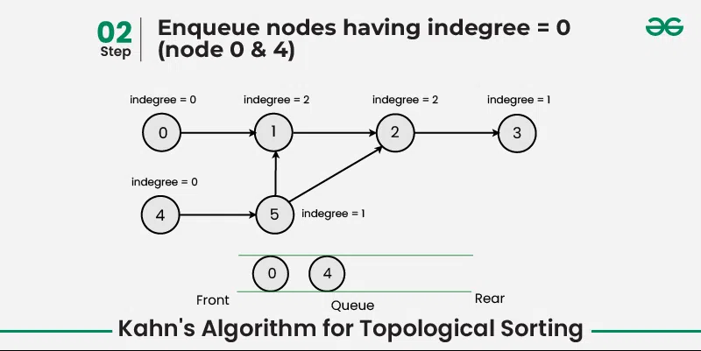
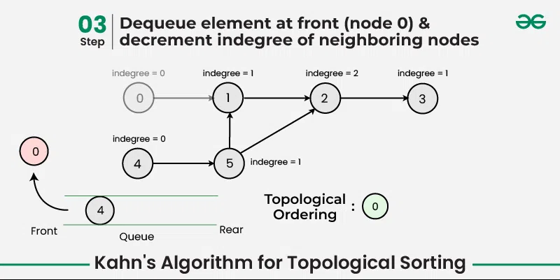
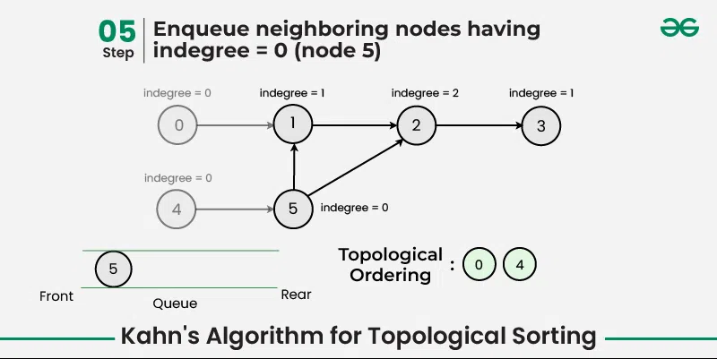
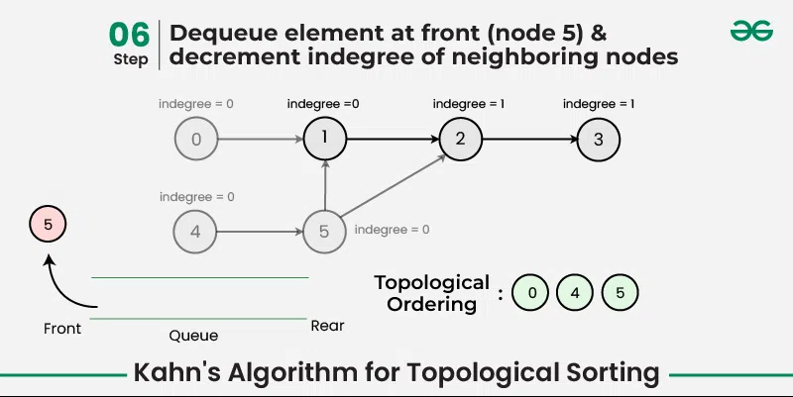
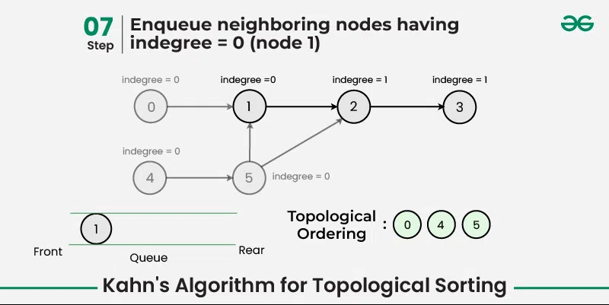

Slide 37
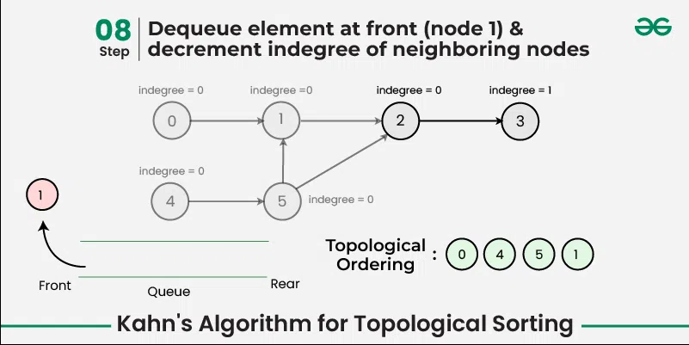
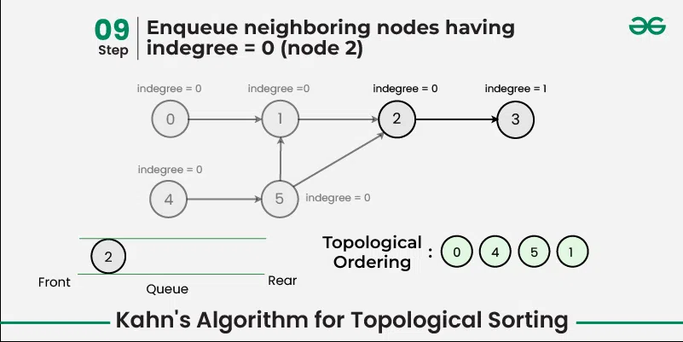
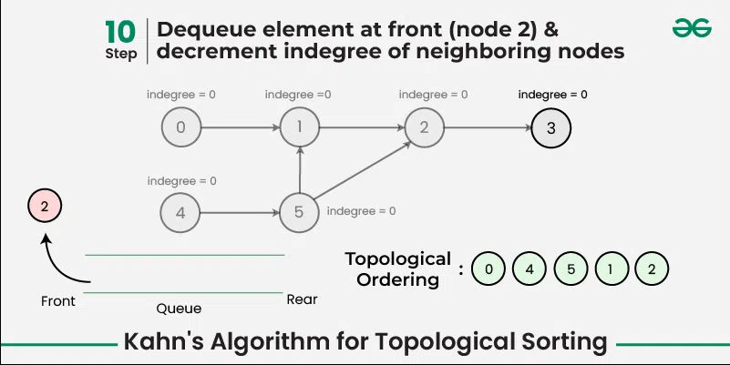
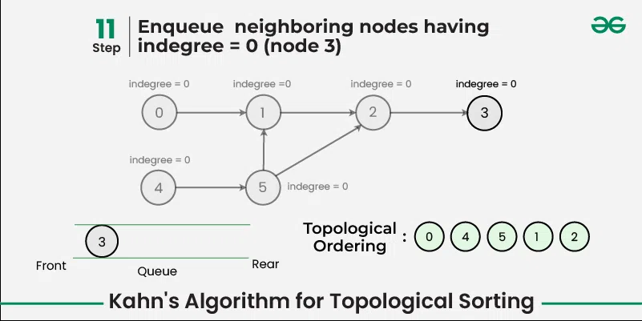
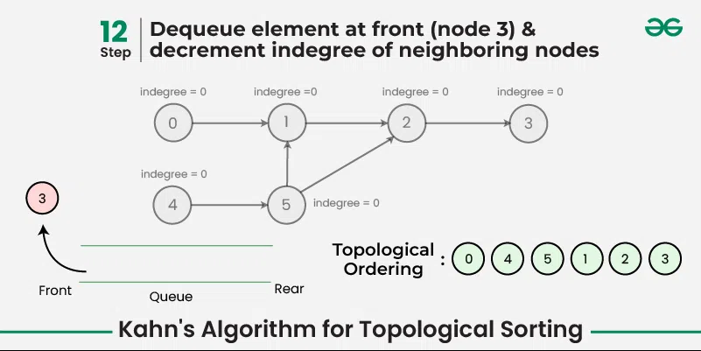
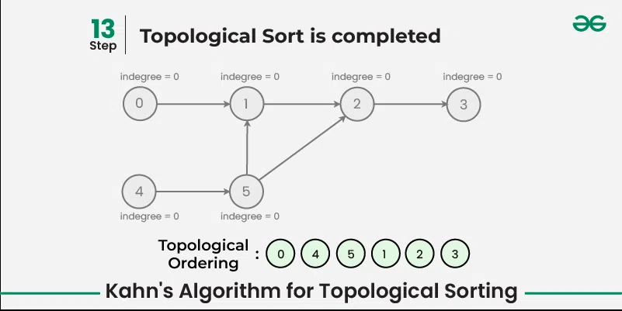

Slide 38
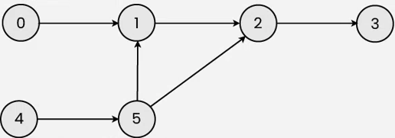
Graph Traversals
Give one DFS pre-order, in-order and post-order traversal of the following graph, and a topological sort.
Starting from node 4:
Pre-order traversal: (4, 5, 1, 2, 3, 0)
Post-order traversal: (3, 2, 1, 5, 4, 0)
Topological Sort: (0, 4, 5, 1, 2, 3)
BFS: (4, 5, 1, 2, 3, 0)
Starting from node 0:
Pre-order traversal: (0, 1, 2, 3, 4, 5)
Post-order traversal: (3, 2, 1, 0, 5, 4)
Topological Sort: (4, 5, 0, 1, 2, 3)
BFS: (0, 1, 2, 3, 4, 5)

Slide 39
References
Breadth-first search in 4 minutes (for a tree)
https://www.youtube.com/watch?v=HZ5YTanv5QE
Depth-first search in 4 minutes (for a tree)
https://www.youtube.com/watch?v=Urx87-NMm6c
Graph Traversals - Breadth First and Depth First (for an undirected graph)
https://www.youtube.com/watch?v=bIA8HEEUxZI
Notes:
Depth First Search Algorithm
https://www.youtube.com/watch?v=iaBEKo5sM7w
Breadth First Search Algorithm
https://www.youtube.com/watch?v=QRq6p9s8NVg

Slide 40
Graph Traversals
Topological Sort
Shortest Path

Slide 41
BFS for (Unweighted) Shortest Path Problem
BFS (Breadth-First Search) can find shortest paths in an unweighted graph
BFS visits nodes in order of their distance from the source vertex, ensuring the first path found to any node is the shortest possible path in terms of the number of edges
Time complexity: O(V+E)
Advantages:
Optimal for unweighted graphs
Simple implementation
Limitations:
Only works for unweighted graphs
(Unweighted) Shortest Path Problem
Given source node s (start) and a target node t, how long is the shortest path from s to t? What edges makeup that path?
Notes:
Not suitable for graphs with negative edges

Slide 42
BFS for Shortest Paths in an Unweighted Graph
...
Map<Node, Edge> PN = ...
Map<Node, Double> SD = ...
PN.put(start, null);
SD.put(start, 0.0);
while (!perimeter.isEmpty()) {
Node from = perimeter.remove();
for (Edge edge : graph.edgesFrom(from)) {
Node to = edge.to();
if (!visited.contains(to)) {
PN.put(to, edge);
SD.put(to, SD.get(from) + 1);
perimeter.add(to);
visited.add(to);
}
}
}
return PN;
}
Keep track of how far each node is from the start with two maps
SD: Shortest Distance from source node
PN: Previous Node stores backpointers: each node remembers what node was used to arrive at it
PERIMETER
A
B
C
D
E
SD
2
E
VISITED
0
start
A
1
C
PN
1
B
2
D
Notes:
The start required no edge to arrive at, and is on level 0
Remember how we got to this point, and what layer this node is part of

Slide 43
Shortest Path Tree
SD
2
E
VISITED
0
The table of SD/PN contains the shortest path tree, which encodes the shortest path and distance from start to every other node
Shortest paths to any node can be obtained from it
Length of shortest path from A to D?
Lookup in SD map: 2
What’s the shortest path from A to D?
Build up backwards from PN: start at D, follow backpointer to B, follow backpointer to A – the shortest path is ABD
start
A
1
C
PN
1
B
2
D
Node | SD | PN
A | 0 | /
B | 1 | A
C | 1 | A
D | 2 | B or C
E | 2 | C
Depending on the order of visiting A’s successors in BFS: either B before C, or C before B, D’s PN may be either B or C
Notes:
A general concept: in this implementation, made up of distances and backpointers

Slide 44
Dijkstra’s Algorithm
Named after its inventor, Edsger W. Dijkstra (1930-2002)
1972 Turing Award
Solves the Shortest Path Problem on a weighted graph
Greedy algorithm: grow the set of nodes whose shortest distance has been computed
start
A
14.0
C
target
12.0
1.5
B
D
9000.2
Notes:
Suppose we want to find shortest path from A to C, using weight of each edge as “distance”
The idea: reminiscent of BFS, but adapted to handle weights
Nodes not in the set will have a “best distance so far”

Slide 45

Edge Relaxation
Relax edge e = u→v with weight w(u,v). (We also write uv to denote u→v)
distTo[u] is length of shortest known path from s to u.
distTo[v] is length of shortest known path from s to v.
PN[v] is the previous vertex on shortest known path from s to v.
If e = u→v gives shorter path to v through u, update distTo[v] and PN[v].
distTo[v] = min(distTo[v], distTo[u] + w(u,v)); PN[v]=u
After relaxing edge uv, the shortest path from s to v is updated to go through vertex u, with cost of 4.4
private void relax(DirectedEdge e)
{
Int u = e.from(), v = e.to();
if (distTo[v] > distTo[u] + w(u,v))
{
distTo[v] = distTo[u] + w(u,v);
PN[v] = u;
}
}
PN[v]=u
3.1
u
1.3
s
v
7.2
OLD distTo[v] = 7.2 > distTo[u] + w(u,v)
= 3.1+1.3 = 4.4
NEW distTo[v] ← distTo[u] + w(u,v) = 4.4, PN[v] = u
x
Previous shortest path from s to v goes through vertex x, with cost of 7.2
Notes:
Dijkstra’s Algorithm is greedy and optimal: any vertex that has been visited should have its shortest distance to the source.

Slide 46
Generic Shortest-paths Algorithm
Generic algorithm (to compute SPT from s)
For each vertex v: distTo[v] = ∞.
For each vertex v: PN[v] = null.
distTo[s] = 0.
Repeat until done:
- Relax any edge.
Proposition. Generic algorithm computes SPT (if it exists) from s.
Pf.
Throughout algorithm, distTo[v] is the length of a simple path from s to v (and PN[v] is its previous vertex on the path).
Each successful relaxation decreases distTo[v] for some v.
The entry distTo[v] can decrease at most a finite number of times.
Efficient implementations. How to choose which edge to relax?
Ex 1. Dijkstra’s algorithm. (no negative weights).
Ex 2. Bellman–Ford algorithm. (negative weights, can detect negative cycles).
Ex 3. Topological sort. (DAG with no directed cycles)
Notes:
Ex 2. Topological sort algorithm. (no directed cycles).

Slide 47
Dijkstra's Algorithm
Initialization:
Set the distance to the source vertex as 0 and to all other vertices as infinity.
Mark all vertices as unvisited and store them in a priority queue.
Main Loop:
Visit the unvisited vertex u with the shortest known distance from the queue.
For each unvisited neighbor vertex v of vertex u, calculate its tentative distance through the current vertex. If this distance is smaller than the previously recorded distance, update it with edge relaxation for edge uv.
Mark the current vertex as visited once all its neighbors are processed.
Termination:
The algorithm continues until all reachable vertices are visited.
Time complexity: O(V log V + V) for Binary Heap implementation
Notes:
Dijkstra’s Algorithm is greedy and optimal: any vertex that has been visited should have its shortest distance to the source.
It works for both undirected and directed graphs. The only difference is the function for getting the neighbors of vertex v, as each undirected edge is treated as two directed edges in opposite directions.)
Notes:
which follows the edge arrow direction for directed graphs

Slide 48
Dijkstra’s Algorithm: Idea
PERIMETER
2
4??
UNKNOWN
0
2
2
3
∞
start
A
B
F
H
1
4
5
10
2
∞
1
9
1
3
G
4
2
C
KNOWN
D
11
1
E
7
12??
Initialization:
Start node has distance 0; all other nodes have distance ∞
At each step:
Pick closest unknown node v
Add it to the “cloud” of known nodes
Update “best-so-far” distances for nodes with edges from v

Slide 49
Dijkstra’s Pseudocode (High-Level)
0
KNOWN
start
A
2
2
PERIMETER
B
5
Suppose we already visited B, SD[D] = 7
Now considering edge (C, D):
oldDist = 7
newDist = 3 + 1
That’s better! Update SD[D], PN[D]
3
3
7??
Similar to “visited” in BFS, “known” is nodes that are finalized (we know their path)
C
u
1
v
D
dijkstraShortestPath(G graph, V start)
Set known; Map PN, SD;
Init all paths to infinite.
initialize SD with all nodes mapped to ∞, except start to 0
while (there are unknown nodes):
let u be the closest unknown node
known.add(u);
Greedy algo: visit closest node first!
for each edge (u,v) from u with weight w:
oldDist = SD.get(v) // previous best path to v
newDist = SD.get(u) + w // what if we went through u?
Consider all nodes reachable from me: would getting there through me be a shorter path than they currently know about?
if (newDist < oldDist):
SD.put(v, newDist)
PN.put(v, u)
Notes:
Dijkstra’s algorithm is all about updating “best-so-far” in SD if we find shorter path!

Slide 50
Dijkstra’s Algorithm: Key Properties
Once a node is marked known, its shortest path is known
Can reconstruct path by following back-pointers (in PN map)
dijkstraShortestPath(G graph, V start)
Set known; Map PN, SD;
initialize SD with all nodes mapped to ∞, except start to 0
while (there are unknown nodes):
let u be the closest unknown node
known.add(u)
for each edge (u,v) to unknown v with weight w:
oldDist = SD.get(v) // previous best path to v
newDist = SD.get(u) + w // what if we went through u?
if (newDist < oldDist):
SD.put(v, newDist)
PN.put(v, u)
While a node is not known, another shorter path might be found
We call this update relaxing the distance because it only ever shortens the current best path
Going through closest nodes first lets us confidently say no shorter path will be found once known
Because not possible to find a shorter path that uses a farther node we’ll consider later

Slide 51
Dijkstra’s Algorithm: Runtime
dijkstraShortestPath(G graph, V start)
Set known; Map PN, SD;
initialize SD with all nodes mapped to ∞, except start to 0
while (there are unknown nodes):
let u be the closest unknown node
known.add(u)
for each edge (u,v) to unknown v with weight w:
oldDist = SD.get(v) // previous best path to v
newDist = SD.get(u) + w // what if we went through u?
if (newDist < oldDist):
SD.put(v, newDist)
PN.put(v, u)
O(|V|)
come back…
How do we find this??
O(1) for HashSet
O(|E|) worst case
O(1) for HashMap
We can use an optimized structure that will tell us the “minimum” distance node, and let us “update distance” as we go…
Use a HeapMinPriorityQueue! (like the one from P3)

Slide 52
Dijkstra’s Algorithm: Runtime
dijkstraShortestPath(G graph, V start)
Set known; Map PN, SD;
initialize SD with all nodes mapped to ∞, except start to 0
while (there are unknown nodes):
let u be the closest unknown node
known.add(u)
for each edge (u,v) to unknown v with weight w:
oldDist = SD.get(v) // previous best path to v
newDist = SD.get(u) + w // what if we went through u?
if (newDist < oldDist):
SD.put(v, newDist)
PN.put(v, u)
update distance in list of unknown nodes
O(|V|)
O(|V|)
O(log|V|)
O(|E|)
O(log|V|)
Final runtime: O(|V|log|V| + |E|log|V|)

Slide 53
Example I
0
2
∞
∞
∞
start
B
2
3
A
F
H
1
4
5
10
2
∞
1
9
∞
3
G
∞
2
C
11
∞
D
1
E
Node | SD | PN
A | ∞
B | ∞
C | ∞
D | ∞
E | ∞
F | ∞
G | ∞
H | ∞
7
Visit Order

Slide 54
Example I
0
2
2??
∞
∞
start
B
2
3
A
F
H
1
4
5
10
2
∞
1
9
1??
3
G
4??
2
C
11
∞
D
1
E
Node | SD | PN
A | 0 | /
B | 2 | A
C | 1 | A
D | 4 | A
E | ∞
F | ∞
G | ∞
H | ∞
7
Visit Order
A

Slide 55
Example I
0
2
2??
∞
∞
start
B
2
3
A
F
H
1
4
5
10
2
∞
1
9
1
3
G
4??
2
C
11
12??
D
1
E
Node | SD | PN
A | 0 | /
B | 2 | A
C | 1 | A
D | 4 | A
E | 12 | C
F | ∞
G | ∞
H | ∞
7
Visit Order
A, C
Notes:
Note how E’s distance is 12 (path length) instead of 11 (edge weight)

Slide 56
Example I
0
2
2
4??
∞
start
B
2
3
A
F
H
1
4
5
10
2
∞
1
9
1
3
G
4??
2
C
11
12??
D
1
E
Node | SD | PN
A | 0 | /
B | 2 | A
C | 1 | A
D | 4 | A
E | 12 | C
F | 4 | B
G | ∞
H | ∞
7
Visit Order
A, C, B
Notes:
Note how
Again, we don’t set F’s pathlen to 2 (the edge weight); we set it to 4 (length of A->B->F)
We don’t update C with distance 7 (A->B->C); its optimal path is already known
We don’t update E with distance 12 (A->B->E); the path length is the same

Slide 57
Example I
0
2
2
4??
∞
start
B
2
3
A
F
H
1
4
5
10
2
∞
1
9
1
3
G
4
2
C
11
12??
D
1
E
Node | SD | PN
A | 0 | /
B | 2 | A
C | 1 | A
D | 4 | A
E | 12 | C
F | 4 | B
G | ∞
H | ∞
7
Visit Order
A, C, B, D
Notes:
Nothing was updated; we already had an optimal path to C

Slide 58
Example I
0
2
2
4
7??
start
B
2
3
A
F
H
1
4
5
10
2
∞
1
9
1
3
G
4
2
C
11
12??
D
1
E
Node | SD | PN
A | 0 | /
B | 2 | A
C | 1 | A
D | 4 | A
E | 12 | C
F | 4 | B
G | ∞
H | 7 | F
7
Visit Order
A, C, B, D, F

Slide 59
Example I
0
2
2
4
7
start
B
2
3
A
F
H
1
4
5
10
2
8??
1
9
1
3
G
4
2
C
11
12??
D
1
E
7
Node | SD | PN
A | 0 | /
B | 2 | A
C | 1 | A
D | 4 | A
E | 12 | C
F | 4 | B
G | 8 | H
H | 7 | F
Visit Order
A, C, B, D, F, H

Slide 60
Example I
0
2
2
4
7
start
B
2
3
A
F
H
1
4
5
10
2
8
1
9
1
3
G
4
2
C
11
11??
D
1
E
Node | SD | PN
A | 0 | /
B | 2 | A
C | 1 | A
D | 4 | A
E | 11 | G
F | 4 | B
G | 8 | H
H | 7 | F
7
Visit Order
A, C, B, D, F, H, G
Notes:
Note how we found a better path to E at last (A->B->F->H->G->E), with cost 11; formerly path A->C->E had cost 12

Slide 61
Example I
0
2
2
4
7
start
B
2
3
A
F
H
1
4
5
10
2
8
1
9
1
3
G
4
2
C
11
11
D
1
E
Node | SD | PN
A | 0 | /
B | 2 | A
C | 1 | A
D | 4 | A
E | 11 | G
F | 4 | B
G | 8 | H
H | 7 | F
7
Visit Order
A, C, B, D, F, H, G, E
Notes:
Done!

Slide 62
Example I: Interpreting the Results
0
2
2
4
7
Now that we’re done, how do we get the path from A to E?
Follow PN backpointers!
SD and PN make up the shortest path tree
start
B
2
3
A
F
H
1
4
5
10
2
8
1
9
1
3
G
4
2
C
11
11
D
1
E
Node | SD | PN
A | 0 | /
B | 2 | A
C | 1 | A
D | 4 | A
E | 11 | G
F | 4 | B
G | 8 | H
H | 7 | F
7
Visit Order
A, C, B, D, F, H, G, E
Notes:
Walk through the chain of “previous” (E->G->H->F->B->A)

Slide 63
Example I: Final Answer (for Exams)
Exam question: Given this directed graph, run Dijkstra’s Algo to find shortest paths starting from source node A. Give the node visit order, and fill in this table of SN (Shortest Distance) and PN (Previous Node), crossing out old items as you find a shortcut path
Visit Order
A, C, B, D, F, H, G, E
Node | SD | PN
A | 0 | /
B | 2 | A
C | 1 | A
D | 4 | A
E | 12 11 | C G
F | 4 | B
G | 8 | H
H | 7 | F
2
2
3
start
A
B
F
H
1
4
5
10
2
1
9
3
G
2
C
11
D
1
E
7

Slide 64
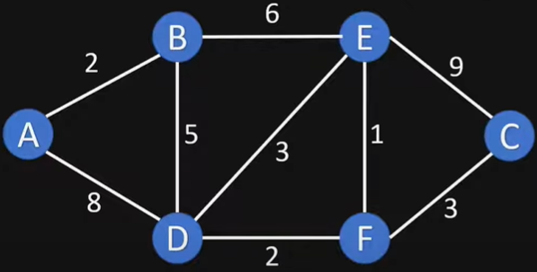
Example II

Slide 65
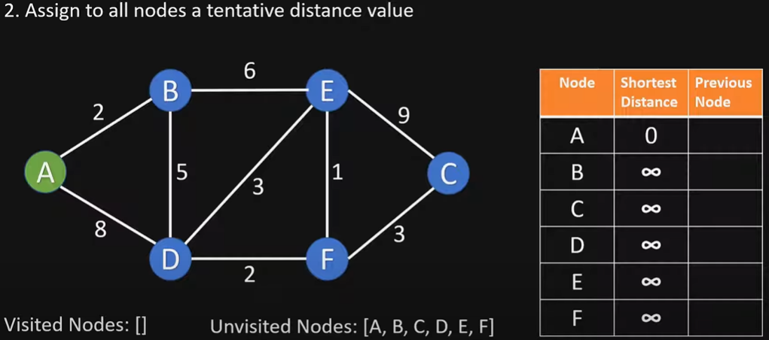
Initialize

Slide 66
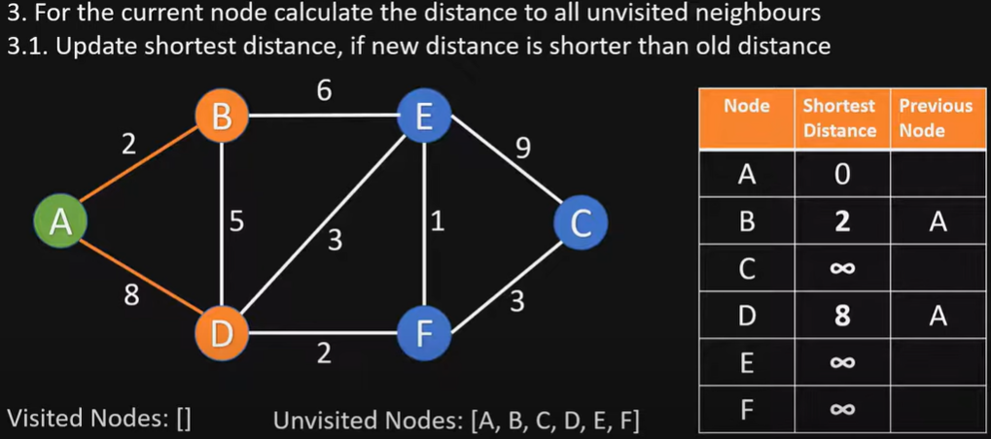
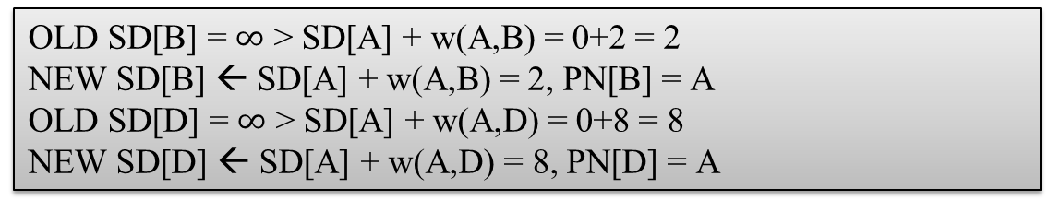
Visit node A
OLD SD[B] = $∞$ > SD[A] + w(A,B) = 0+2 = 2
NEW SD[B] ← SD[A] + w(A,B) = 2, PN[B] = A
OLD SD[D] = $∞$ > SD[A] + w(A,D) = 0+8 = 8
NEW SD[D] ← SD[A] + w(A,D) = 8, PN[D] = A

Slide 67
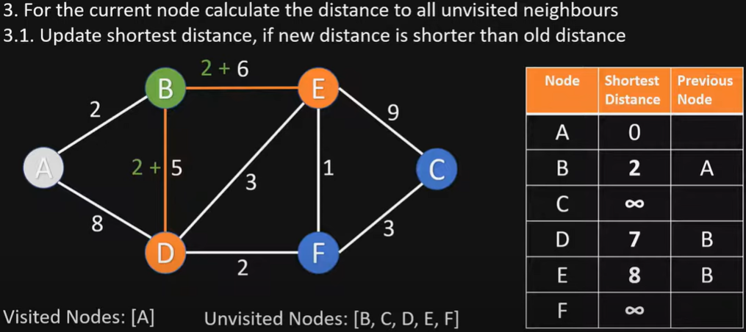
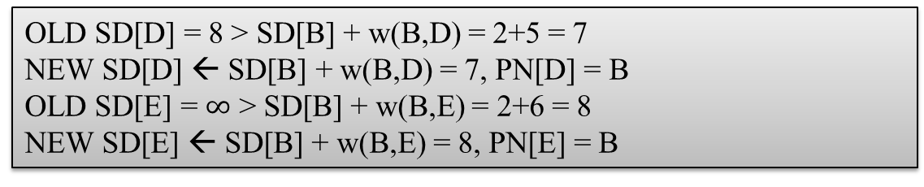
Visit node B
OLD SD[D] = 8 > SD[B] + w(B,D) = 2+5 = 7
NEW SD[D] ← SD[B] + w(B,D) = 7, PN[D] = B
OLD SD[E] = $∞$ > SD[B] + w(B,E) = 2+6 = 8
NEW SD[E] ← SD[B] + w(B,E) = 8, PN[E] = B

Slide 68
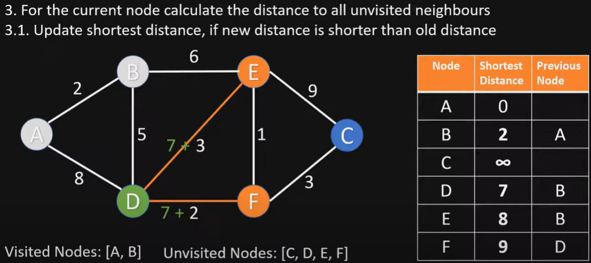
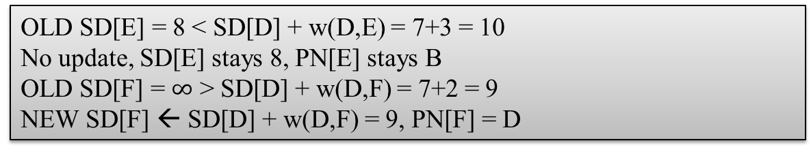
Visit node D
OLD SD[E] = 8 < SD[D] + w(D,E) = 7+3 = 10
No update, SD[E] stays 8, PN[E] stays B
OLD SD[F] = $∞$ > SD[D] + w(D,F) = 7+2 = 9
NEW SD[F] ← SD[D] + w(D,F) = 9, PN[F] = D

Slide 69
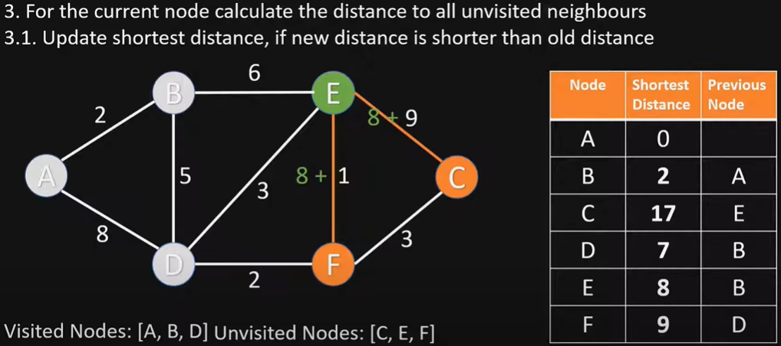
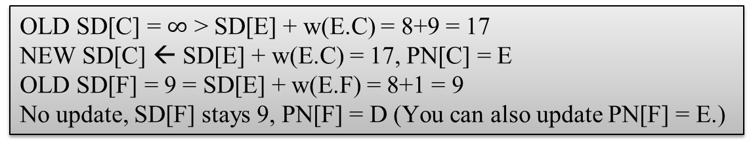
Visit node E
OLD SD[C] = $∞$ > SD[E] + w(E.C) = 8+9 = 17
NEW SD[C] ← SD[E] + w(E.C) = 17, PN[C] = E
OLD SD[F] = 9 = SD[E] + w(E.F) = 8+1 = 9
No update, SD[F] stays 9, PN[F] = D (You can also update PN[F] = E.)

Slide 70
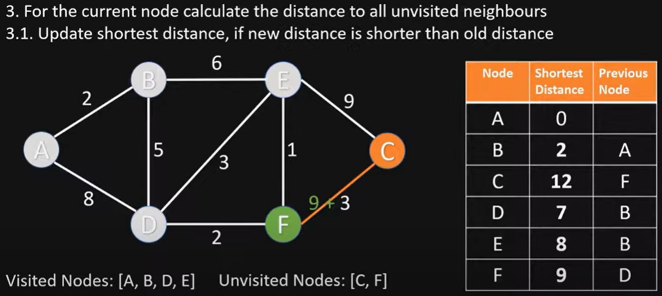
Visit node F
OLD SD[C] = 17 > SD[F] + w(F,C) = 9+3 = 12
NEW SD[C] ← SD[F] + w(F,C) = 12, PN[C] = F

Slide 71
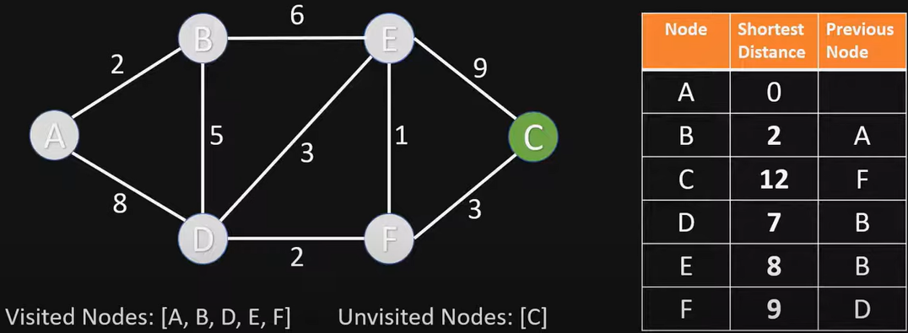
Visit node C
Nothing changes, since C has no unvisited neighbor nodes

Slide 72
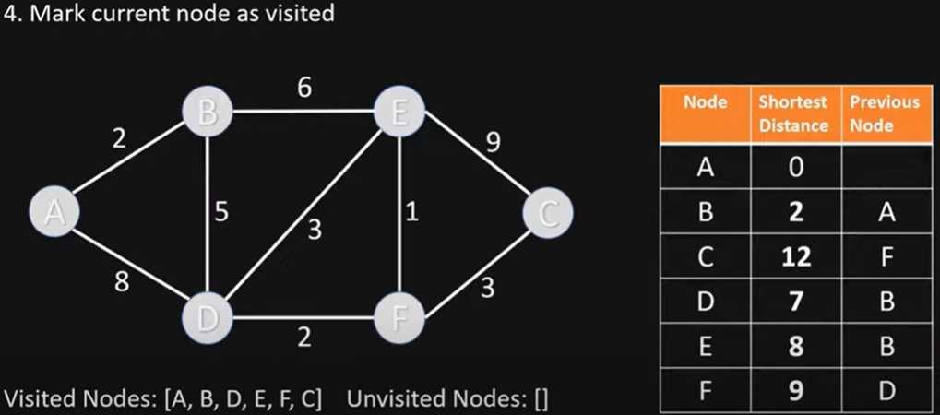
End of Algorithm
Table now contains the shortest distance to each node N from the source node A, and its previous node in the shortest path

Slide 73
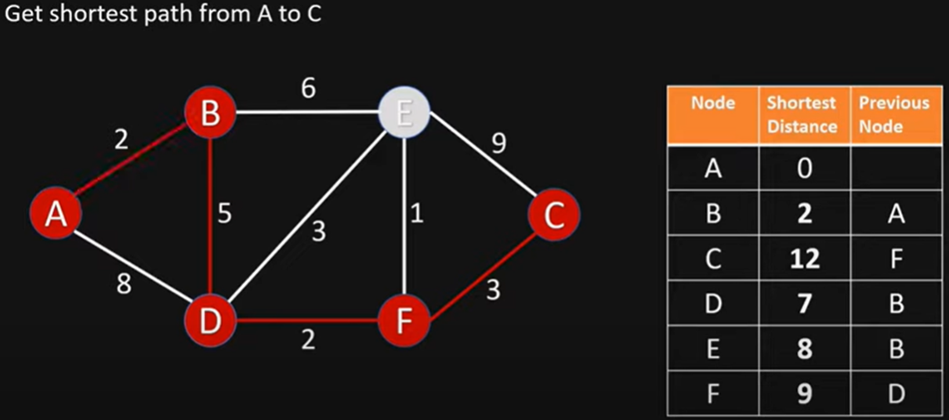
Getting the Shortest Path from A to C
C’s previous node is F; F’s previous node is D; D’s previous node is B; B’s previous node is A
Shortest Path from A to C is ABDFC

Slide 74
Example II: Final Answer (for Exams)
Exam question: Given this directed graph, run Dijkstra’s Algo to find shortest paths starting from source node A. Give the node visit order, and fill in this table of SN (Shortest Distance) and PN (Previous Node), crossing out old items as you find a shortcut path
Visit Order
A, B, D, E, F, C
Node | SD | PN
A | 0 | /
B | 2 | A
C | 17 12 | E F
D | 8 7 | A B
E | 8 | B
F | 9 | D

Slide 75

Example III
choose node 5
relax all edges adjacent from 5
choose node 2
relax all edges adjacent from 2
choose node 3
relax all edges adjacent from 3
choose node 6
relax all edges adjacent from 6
1
v SD
Visit Order
0, 1, 7, 4, 5, 2, 3, 6
15
3
$$∞$$
$∞$ $∞$
$$∞$$
$$∞$$
$$∞$$
$$∞$$
$$∞$$
0
5
17
20
9
14
29
8
15
17
13
26
14
25
0
1
2
3
4
5
6
7
5
4
12
0
3
Node | SD | PN
0 | 0 | /
1 | 5 | 0
2 | 17 15 14 | 1 7 5
3 | 20 17 | 1 2
4 | 9 | 0
5 | 14 13 | 7 4
6 | 29 26 25 | 4 5 2
7 | 8 | 0
8
7
2
7
9
9
5
6
1
5
11
v PN
4
4
13
6
0
1
2
3
4
5
6
7
-
-
-
-
-
-
-
-
0
1
1
0
7
4
0
7
2
4
5
5
2
20
choose source node 0
relax all edges adjacent from 0
choose node 1
relax all edges adjacent from 1
choose node 7
relax all edges adjacent from 7
choose node 4
relax all edges adjacent from 4
Notes:
Consider nodes in increasing order of distance from s
(non-tree node with the lowest SD[ ] value).
Add node to tree and relax all edges pointing from that node.

Slide 76
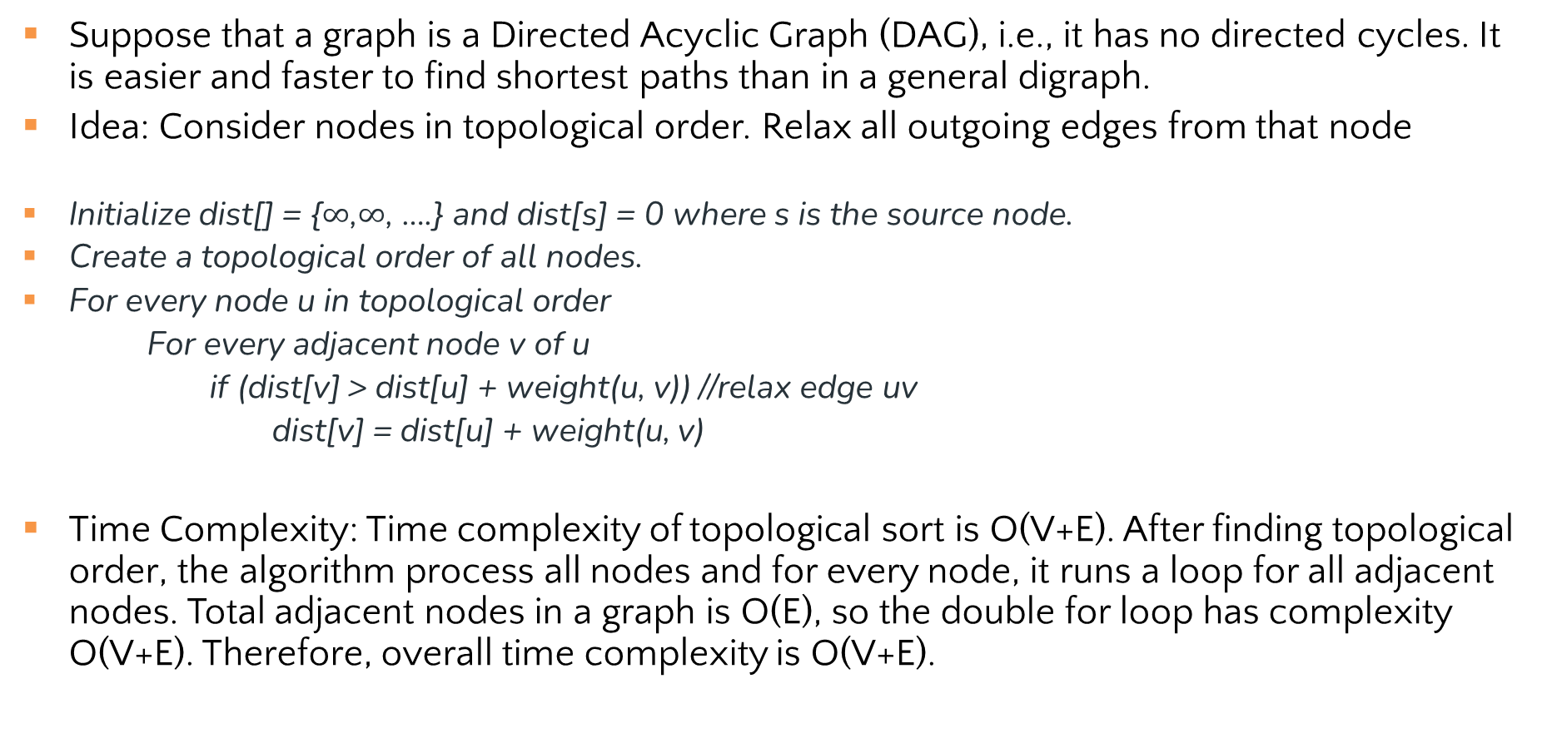
Topological Sort for Shortest Paths in Edge-weighted DAG
Suppose that a graph is a Directed Acyclic Graph (DAG), i.e., it has no directed cycles. It is easier and faster to find shortest paths than in a general digraph.
Idea: Consider nodes in topological order. Relax all outgoing edges from that node
Initialize dist[] = {$∞$,$∞$, ….} and dist[s] = 0 where s is the source node.
Create a topological order of all nodes.
For every node u in topological order
For every adjacent node v of u
if (dist[v] > dist[u] + weight(u, v)) //relax edge uv
dist[v] = dist[u] + weight(u, v)
Time Complexity: Time complexity of topological sort is O(V+E). After finding topological order, the algorithm process all nodes and for every node, it runs a loop for all adjacent nodes. Total adjacent nodes in a graph is O(E), so the double for loop has complexity O(V+E). Therefore, overall time complexity is O(V+E).

Slide 77
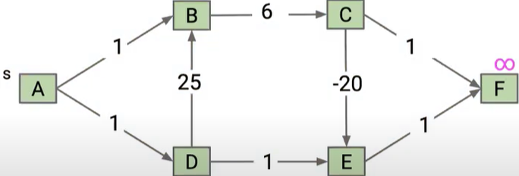
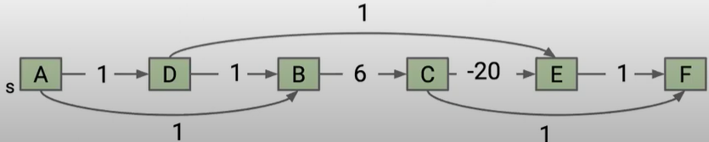
Topological Sort Example I
Consider this DAG and a topological order ADBCEF

Slide 78
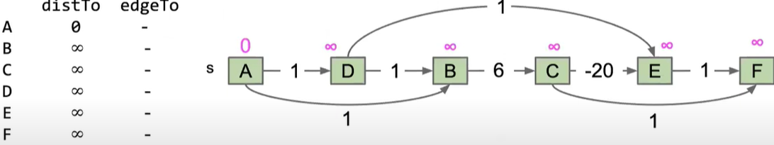


Initialize
Visit A
Visit D

Slide 79



Visit B
Visit C
8
C
C
Visit E

Slide 80
Topological Sort Example I: Final Answer (for Exams
Visit Order
A, D, B, C, E, F
Node | SD | PN
A | 0 | /
B | 1 | A
C | 7 | B
D | 1 | A
E | 2 -13 | D C
F | 8 -12 | C E

Slide 81

Topological Sort Example II
Consider this DAG and a topological order 01475236
V SD
Visit Order
0, 1, 4, 7, 5, 2, 3, 6
0
1
2
3
4
5
6
7
$$∞$$
$∞$ $∞$
$$∞$$
$$∞$$
$$∞$$
$$∞$$
$$∞$$
0
5
17
20
9
13
29
8
15
17
26
14
25
0 1 4 7 5 2 3 6
Node | SD | PN
0 | 0 | /
1 | 5 | 0
2 | 17 15 14 | 1 7 5
3 | 20 17 | 1 2
4 | 9 | 0
5 | 13 | 4
6 | 29 26 25 | 4 5 2
7 | 8 | 0
1
15
3
5
4
12
0
3
v PN
8
7
2
0
1
2
3
4
5
6
7
-
-
-
-
-
-
-
-
0
1
1
0
4
4
0
7
2
5
5
2
7
9
9
5
6
1
5
11
4
4
13
20
6

Slide 82
Topological Sort Example III
Consider this DAG and a topological order ABCDE
Visit Order
0, 1, 4, 7, 5, 2, 3, 6
B
Node | SD | PN
A | 0
B | 10 | A
C | 1 | A
D | -10 | B
E | -9 | D
10
-20
A
D
1
E
1
1
C

Slide 83
Topological Sort Example III
Consider this DAG and a topological order ACBDE
Different visit order/topological order results in different table of SD/PN
Visit Order
0, 1, 4, 7, 5, 2, 3, 6
B
Node | SD | PN
A | 0
B | 10 | A
C | 1 | A
D | 2 -10 | C B
E | -9 | D
10
-20
A
D
1
E
1
1
C

Slide 84
Single Source Shortest-paths Algorithms Summary
Algorithm | Restriction | Worst-Case Complexity
Dijkstra (Fibonacci heap) | Undirected or directed graph; no negative weights/cycles | O(V log V + E)
Topological Sort | Directed Acyclic Graph (DAG) (directed graph, no cycles) | O(E+V)
Notes:
typical case
worst case O(VlogV+E)
Remark 1. Directed cycles make the problem harder.
Remark 2. Negative weights make the problem harder.
Remark 3. Negative cycles makes the problem ill-defined.
E+V
E+V
Dijkstra (binary heap)
E log V
E log V
Bellman-Ford
EV
EV

Slide 85
Review: Key Features
Once a node is marked known, its shortest path is known
Can reconstruct path by following backpointers
While a node is not known, another shorter path might be found!
The “Order Added to Known Set” is unimportant
A detail about how the algorithm works (client doesn’t care)
Not used by the algorithm (implementation doesn’t care)
It is sorted by path-distance; ties are resolved “somehow”
If we only need path to a specific node, can stop early once that node is known
Because its shortest path cannot change!
Return a partial shortest path tree

Slide 86
Greedy Algorithms
At each step, do what seems best at that step
“instant gratification”
“make the locally optimal choice at each stage”
Dijkstra’s is “greedy” because once a node is marked as “processed” we never revisit
This is why Dijkstra’s does not work with negative edge weights
Other examples of greedy algorithms are:
Kruskal and Prim’s minimum spanning tree algorithms (next week)
Huffman compression

Slide 87
Breadth-First Search Visualized and Explained
https://www.youtube.com/watch?v=N6wicLpEmHY&list=PLnZHgAO8ocBv6XRqZkqQjrsIJijn82UUC&index=5
Depth-First Search Visualized and Explained
https://www.youtube.com/watch?v=5GcSvYDgiSo&list=PLnZHgAO8ocBv6XRqZkqQjrsIJijn82UUC&index=6
Topological Sort Visualized and Explained
https://www.youtube.com/watch?v=7J3GadLzydI&list=PLnZHgAO8ocBv6XRqZkqQjrsIJijn82UUC&index=7

